Slide 1
Feeding a Newborn

Slide 2
OBJECTIVE
Explain the importance of feeding newborn babies.

Slide 3
Benefits of breastfeeding
Antibodies and other germ-fighting factors pass from a mother to her baby and strengthen the immune system.
Breast milk's components — lactose, protein (whey and casein), and fat and vitamins — are easily digested by a newborn.
Less diarrhea or constipation.

Slide 4
Benefits of breastfeeding
Breast milk doesn't cost a cent and is convenient.
Studies show that breastfeeding helps lower the risk of breast cancer, high blood pressure, diabetes, and cardiovascular disease.

Slide 5
Breastfeeding Challenges
Breastfeeding can be easy for some mothers, but take a while to get used to for others.
Breastfeeding can be painful for women throughout feedings, sometimes risking infection.
Breastfeeding requires a big time commitment from mothers, when babies feed often.

Slide 6
Breastfeeding Challenges
Breastfed babies do need to eat every 2 or 3 hours because it is digested quickly.
Women who are breastfeeding need to be aware of what they ingest, since these can be passed to the baby through the breast milk.

Slide 7
Benefits of Formula Feeding
Commercially prepared infant formulas are designed as a nutritious alternative to breast milk,
Formula feeding allows mom to share the feeding duties and helps her partner.
Because formula is less digestible than breast milk.
Women who opt to formula feed don't have to worry about the things they eat or drink that could affect their babies.

Slide 8
Formula Feeding Challenges
Lack of antibodies and doesn’t added protection against infection and illness that breast milk does.
Can't change as the baby's needs change.
Expense. During the first year of life, the cost of basic formula can run over $2,500.
Possibility of producing gas and constipation.

Slide 9
Different stages of breast milk
There are three different stages of breast milk: colostrum, transitional milk and mature milk.
Colostrum: Your first milk that lasts between two and four days after birth.
Transitional milk: Begins approximately four days after birth and lasts about two weeks.
Mature milk: Milk that lasts from approximately 14 days after birth until you are done producing milk.

Slide 10
Difference Between colostrum and mature milk.

Slide 11
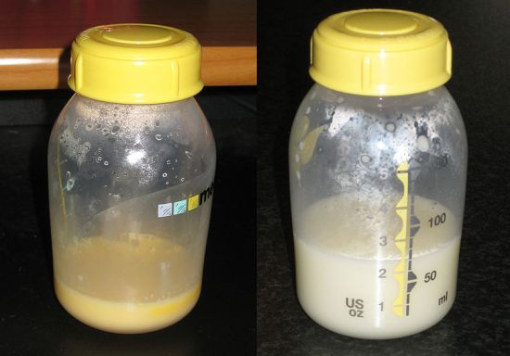

Slide 12
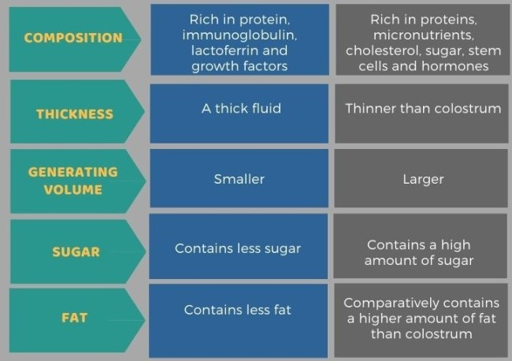

Slide 13
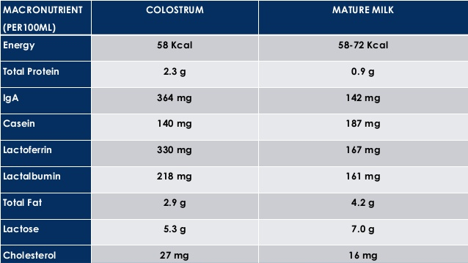

Slide 14

https://www.youtube.com/watch?v=i1UMnKduosE

